Slide 1
Word2Vec
Krzysztof Kolasiński - January 2017

Slide 2

Vector representation of words - motivation
Some warning:
most of the material can be found in the internet
I use mine notation (which is sometimes different that in papers)
The notation can change during slides - mostly because of variety of problems

Slide 3
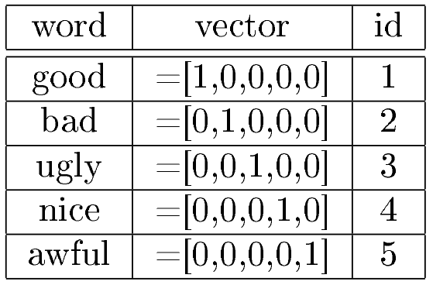
Vector representation of words - motivation
NLP - Natural Language Processing
If we want to process text or document words must be represented as numbers (or vectors).
We start with assumption of no knowledge about semantic and lexical similarities between the words in our corpus.
This result with sparse vectors in vocabulary (one-hot encoding):

Slide 4
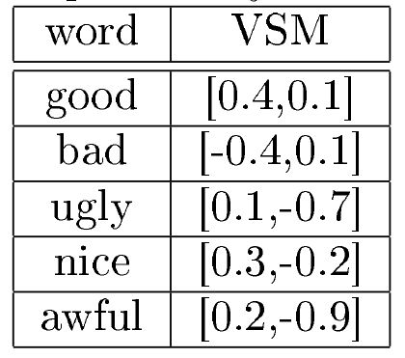
Vector representation of words - motivation
Vector representation of words:
The words are really independent, orthogonality guarantees that we cannot express one word in terms of other: linear independence.
We just need to store ids of each word.
Low dimensional representation (Vector Space Models) ???
We want to build a model which will capture similarities among words.
The size of the latent space is parameter of the model.
The model should give that: similar words are represented by similar vectors (in terms of some metric - e.g. cosine distance)

Slide 5
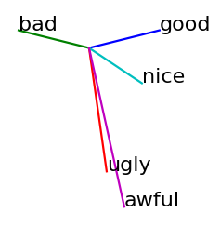
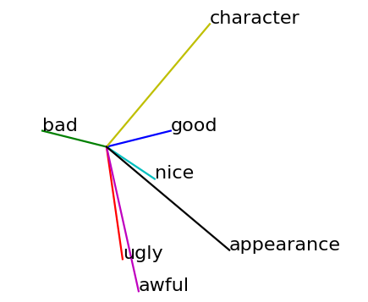
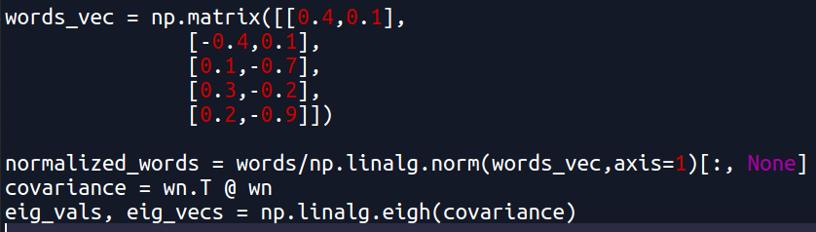
Vector representation of words - motivation
Word embedding (toy example):
Plotting eigenvectors of covariance matrix of embedded words:
Conclusion:
size of the latent space determine capacity of the model

Slide 6
Vector representation of words
Computing low dimensional representation
how to do it?
word2vec(x)
Distributional Hypothesis - states that words that appear in the same contexts share semantic meaning.
There are two groups of approaches for word2vec:
count-based methods - like GloVe (global word co-occurrence statistics)
predictive - like CBOW, Skip-Gram (local co-occurrence )

Slide 7
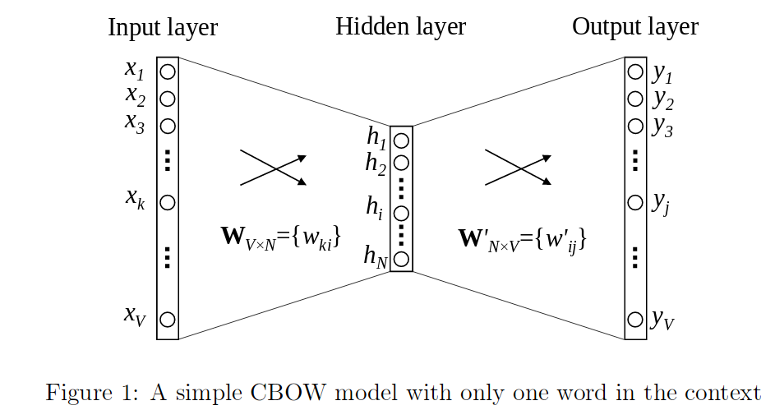
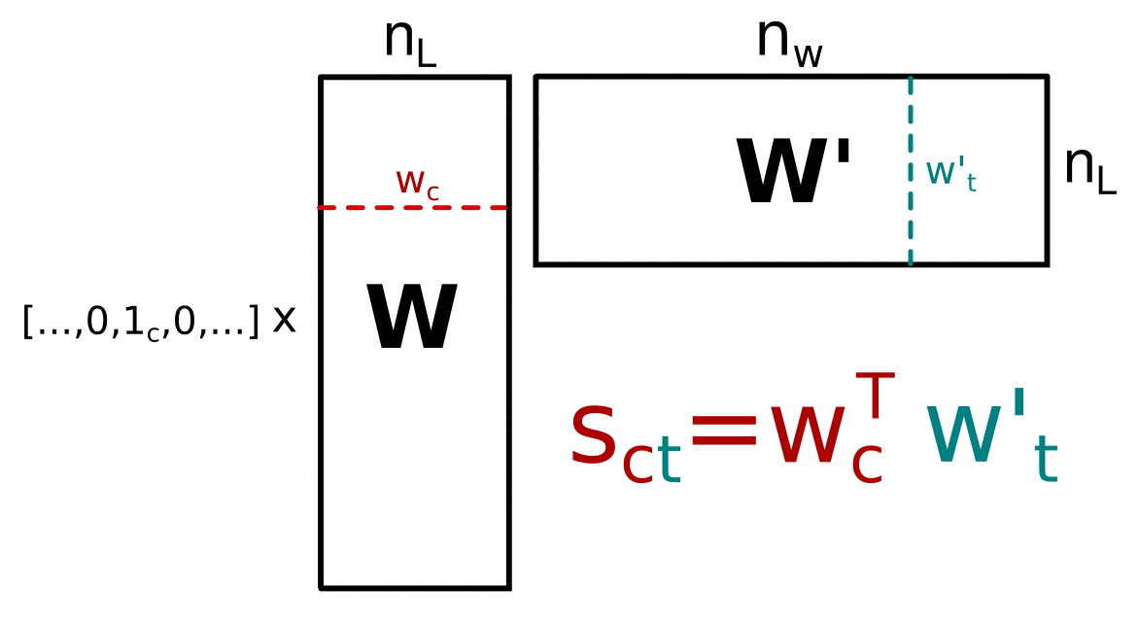
CBOW - Continuous Bag-of-Word
One word context
This is nothing else like shallow neural network with one hidden layer:
input word
(sparse representation)
Parameters:
n_{L} - the size of the latent space
W, W’ - matrices we are looking for
score - that for given input word c we obtain word t
sometimes called projection layer

Slide 8
CBOW - Continuous Bag-of-Word
One word context
This is nothing else like shallow neural network with one hidden layer:
“the quick brown fox jumped over the lazy dog”
We start from creating context/target pairs: (the : quick, quick : brown, brown : fox, ...)
The words are converted to sparse orthogonal representation: (1 : 2, 2 : 3, 3 : 4, ...)
For each input word k we will maximize the probability of that the target word (brown) will appear after context word (quick) i.e. we want to maximize score s_{kp}.

Slide 9
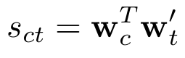
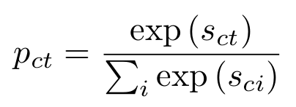
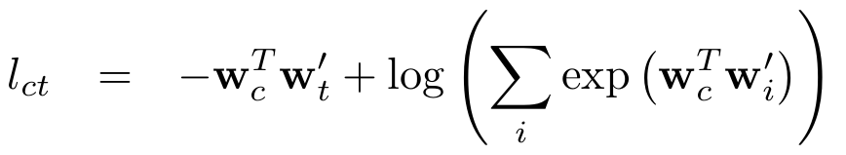
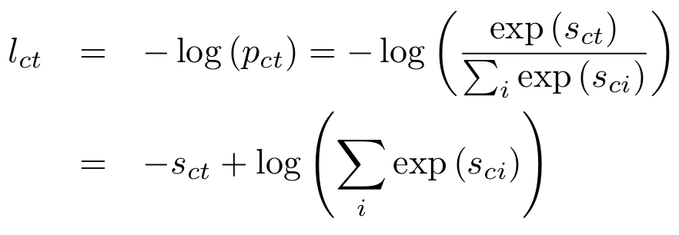
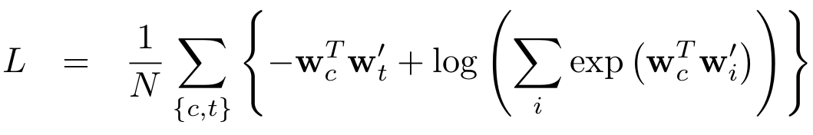
CBOW - Continuous Bag-of-Word
One word context
“the math”
For a given context/target pair we compute score
The probability of observing word p for given input word k is computed with Softmax
The same but expressed in term of W and W’ matrices
The context/target pair loss is defined as
Total loss is defined as
Note!
The sum represent scan over all words in document: i.e. word by word.
{c,t} - is the context/target pair

Slide 10
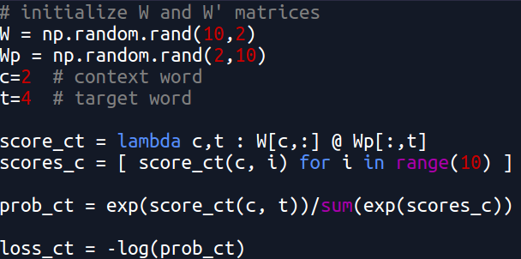
CBOW - Continuous Bag-of-Word
One word context
“the math”
For a given context/target pair we compute score
The probability of observing word p for given input word k is computed with Softmax
The context/target pair loss is defined as
Naive implementation of loss:

Slide 11
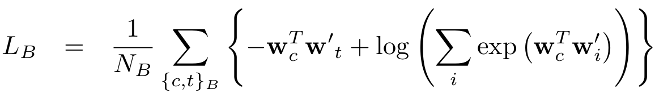
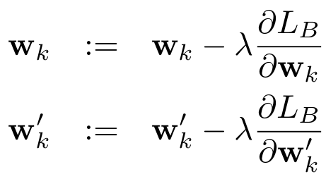
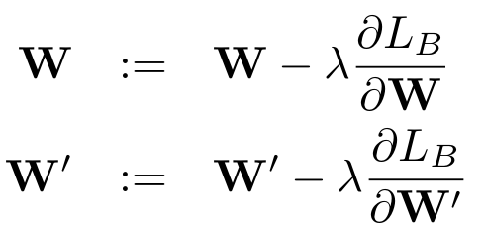
CBOW - Continuous Bag-of-Word
One word context
“the math”
The total loss is never computed
Instead we compute it over mini-batches
The minimization of mini-batch loss is done with Gradient descent:
Or we can look at vector update instead of whole matrix:

Slide 12
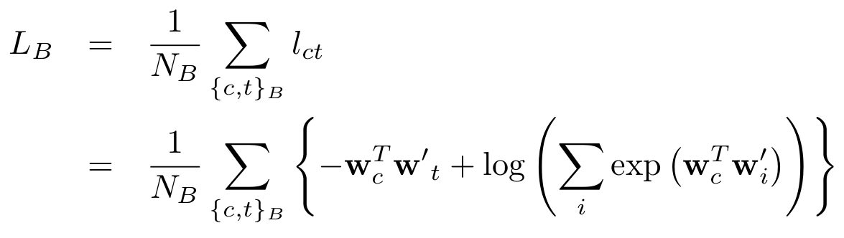
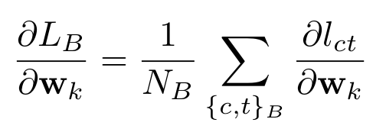
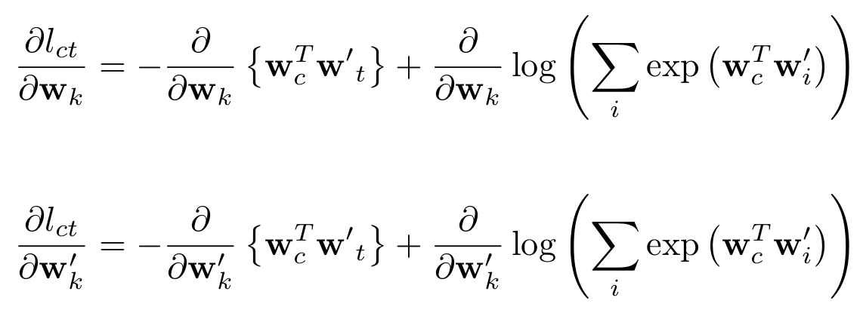
CBOW - Continuous Bag-of-Word
One word context
“the math”
The total loss
The total gradient is a sum of local gradients:

Slide 13
CBOW - Continuous Bag-of-Word
One word context
“the math”
Gradients have particular properties:
=0 if c<>k
W is updated only at one row which corresponds to the context word.
Consider case when some word appeared e.g. 10 times and n_{L}=100…
W’ is updated for every word in the vocabulary.
Consider vocabulary of size 10⁶….
We will tackle computational improvements in the nexts slides.

Slide 14
CBOW - Continuous Bag-of-Word
One word context
“the quick brown fox jumped over the lazy dog”
We start from creating context/target pairs: (the : quick, quick : brown, brown : fox, ...)
The words are converted to sparse orthogonal representation: (1 : 2, 2 : 3, 3 : 4, ...)
This is what we know so far… any question?

Slide 15
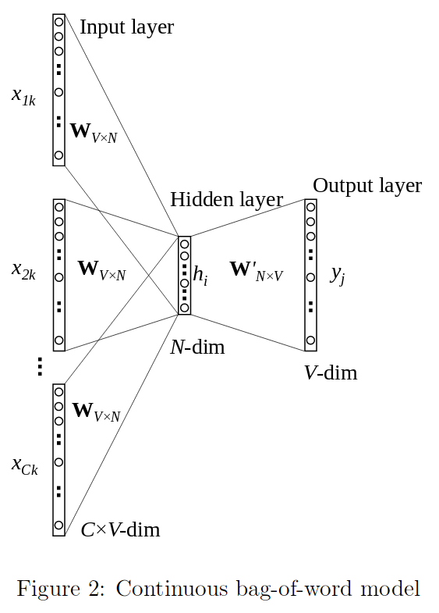
CBOW - Continuous Bag-of-Word
2. Multi word context
“the quick brown fox jumped over the lazy dog”
We start from creating context/target groups: (the, brown : quick, quick, fox : brown, brown, jumped : fox, ...)
The words are converted to sparse orthogonal representation: (1,3 : 2, 2,4 : 3, 3,5 : 4, ...)
one word context

Slide 16
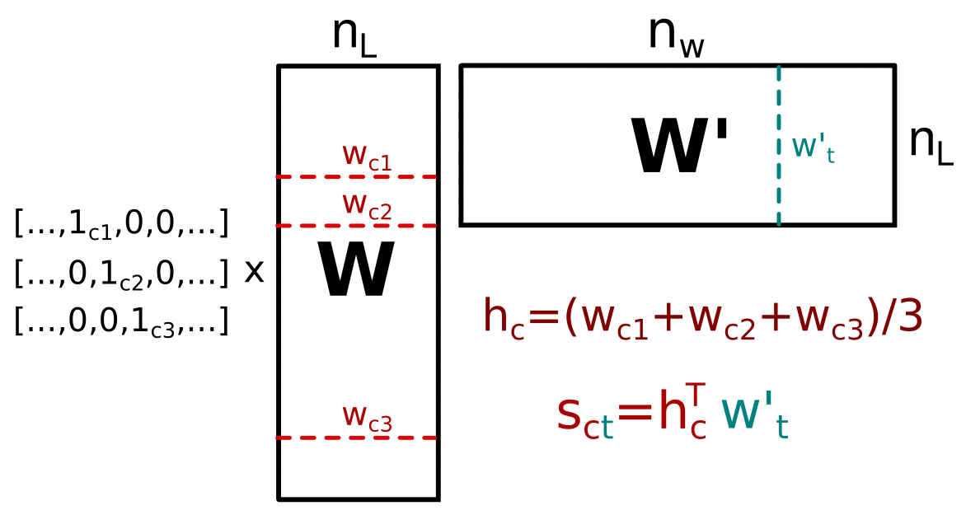
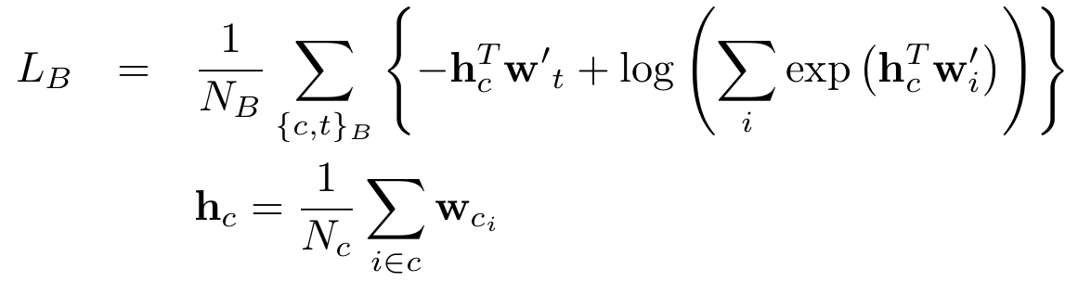
CBOW - Continuous Bag-of-Word
2. Multi word context
“the math was:
h_{c} is an average of context words c
target word
“the quick brown fox jumped over the lazy dog”
Note:
Same behaviour while computing gradients but N_{c} context words is now affected during backpropagation
context window size = 1

Slide 17
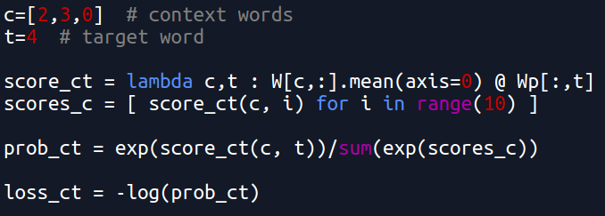
CBOW - Continuous Bag-of-Word
2. Multi word context
“the math remains the same”
h_{c} is an average of context words c
Code remain almost the same:

Slide 18
CBOW - any questions???
2. Multi word context
“the quick brown fox jumped over the lazy dog”
We start from creating context/target groups: (the, brown : quick, quick, fox : brown, brown, jumped : fox, ...)
The words are converted to sparse orthogonal representation: (1,3 : 2, 2,4 : 3, 3,5 : 4, ...)
one word context

Slide 19
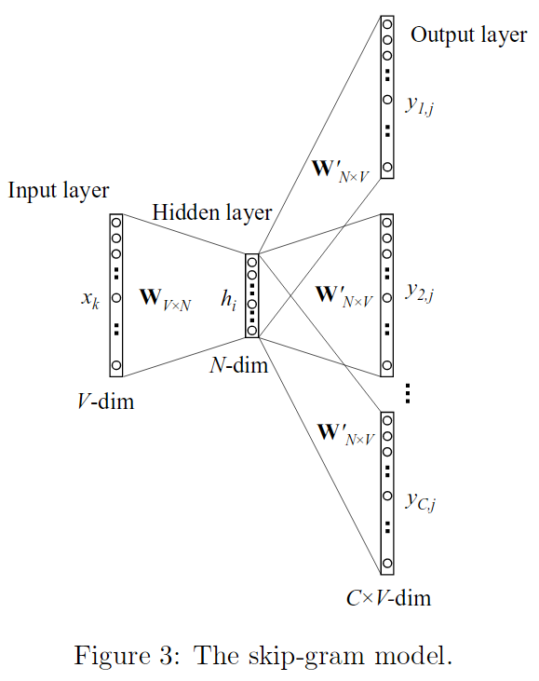
CBOW and Skip-Gram Model
2. Multi word context
3. Skip Gram Model
“the quick brown fox jumped over the lazy dog”
context words
target word

Slide 20
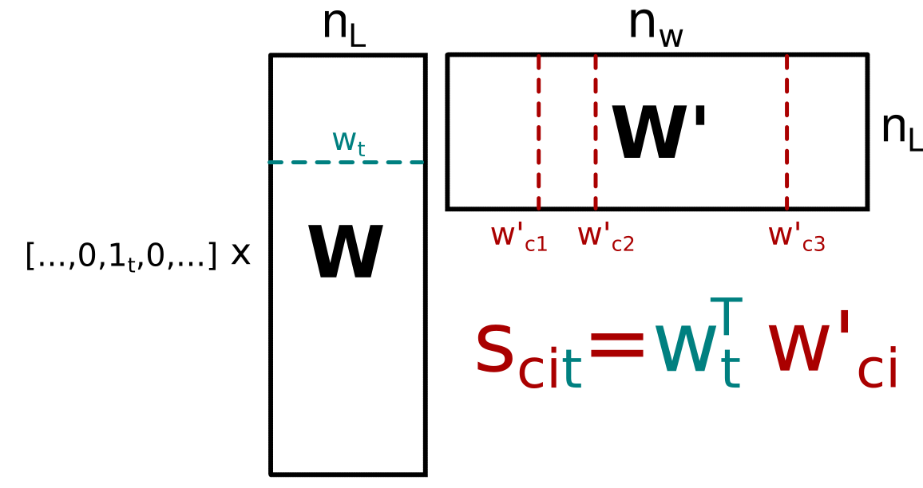
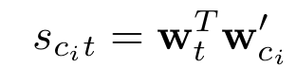
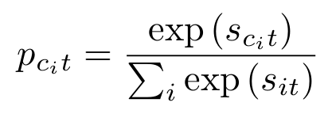
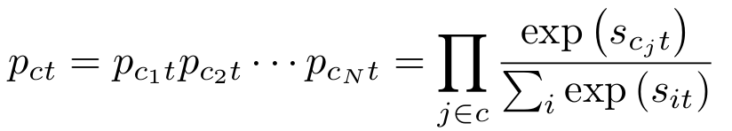
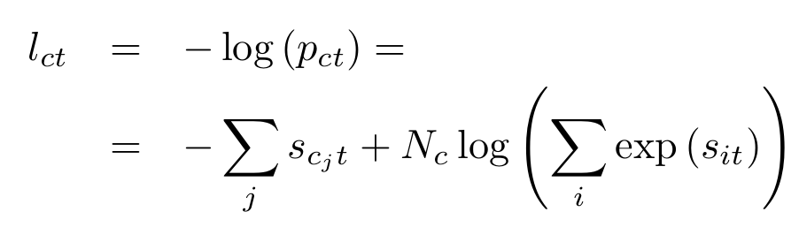
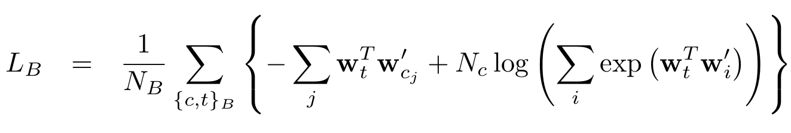
Skip-Gram Model
“the math remains the same”
For a given context/target pair we compute score
and probability:
Total probability of observing all context words given target is then
With loss
With loss per mini-batch
Note: Gradients will have similar form but a little different behaviour

Slide 21
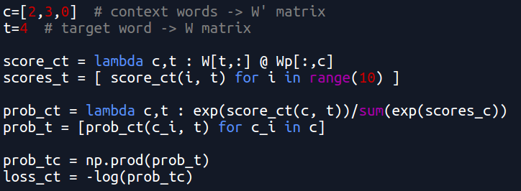
Skip-Gram Model
“the math remains the same”
For a given context/target pair we compute score
and probability:
Total probability of observing all context words given target is then
With loss

Slide 22
CBOW
smoothes context, so average out statistical information
faster to train
better in accuracy for frequent words
Inefficient usage of statistics
Can capture complex patterns beyond word similarity
Skip-Gram
no smoothing effect, should give better results than CBOW
slower to train
better in accuracy for rare words
Inefficient usage of statistics
Can capture complex patterns beyond word similarity

Slide 23
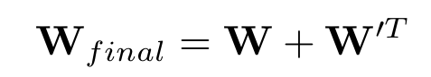
word2vec final question?
Skip-Gram
This will depend on implementation, but good solution is to take sum of both matrices
The models are trained until converge
Which matrix take to represent the words embeddings???
however this can be done arbitrarily
(there is no universal recipe for doing this)
CBOW

Slide 24
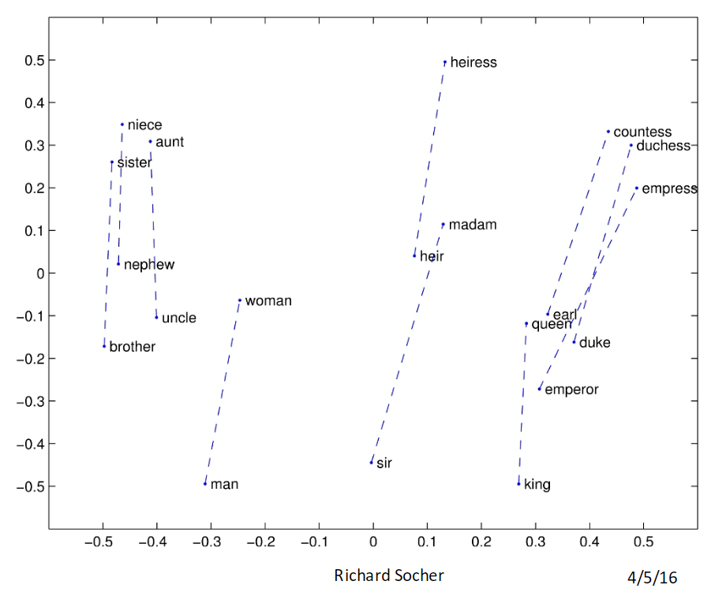
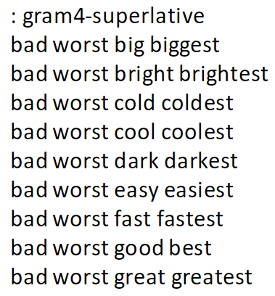
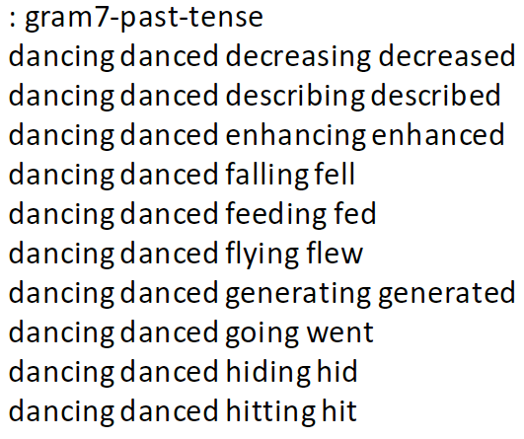
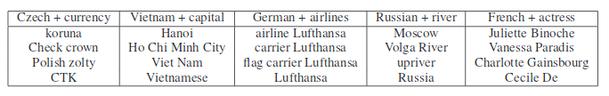
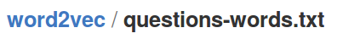
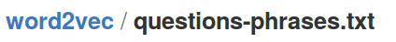
word2vec evaluation
The task is non trivial (unsupervised learning): There are special datasets which can be used for model evaluation
Testing words analogies:
Vector compositionality using element-wise addition
Evaluation data sets can be found at:
from Skip-Gram paper: Distributed Representations of Words and Phrases and their Compositionality

Slide 25
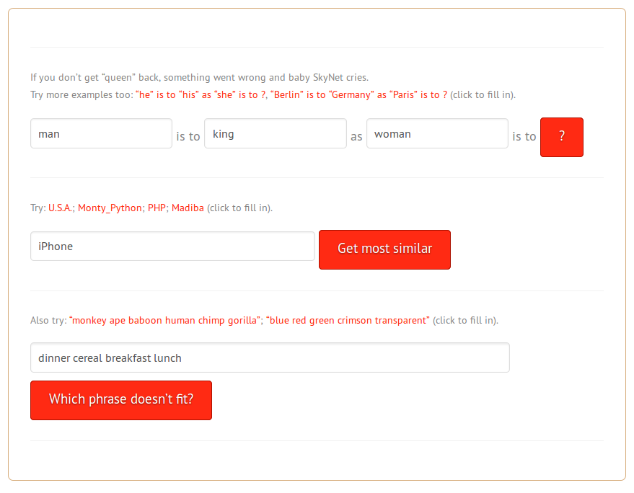
word2vec - the fun part
Time for fun!
https://rare-technologies.com/word2vec-tutorial/

Slide 26
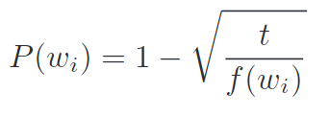
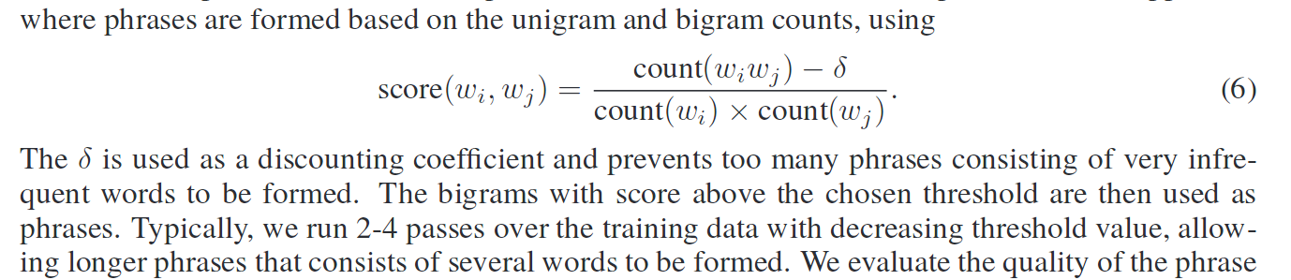
Improving speed and accuracy
Frequent words will dominate gradients e.g. word “the” will appear before almost every noun: the cat, the dog.
solution (pre processing of the document with sentences):
remove super frequent words from corpus before training
subsample frequent words before training :
probability that word w_{i} will be rejected from training set
chosen threshold (hyperparameter)
word frequency
B. Frequent phrases: some words occur naturally in pairs, triples etc: New York Times, Microsoft Office, ...
phrase threshold (hyperparameter)

Slide 27
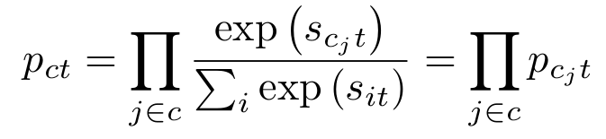
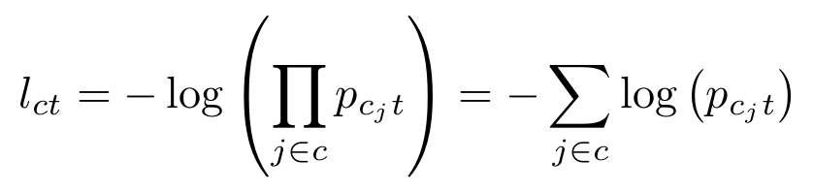
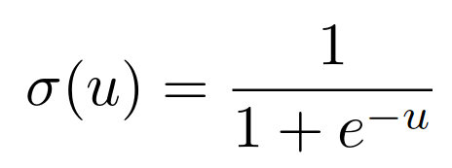
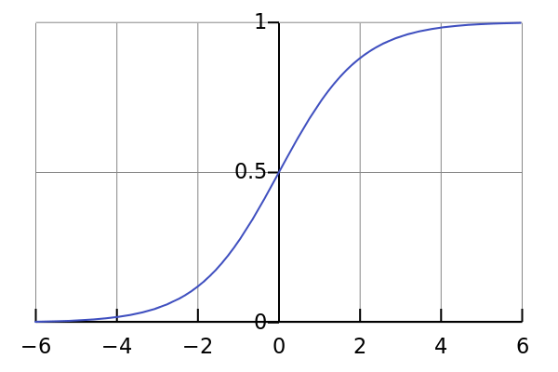
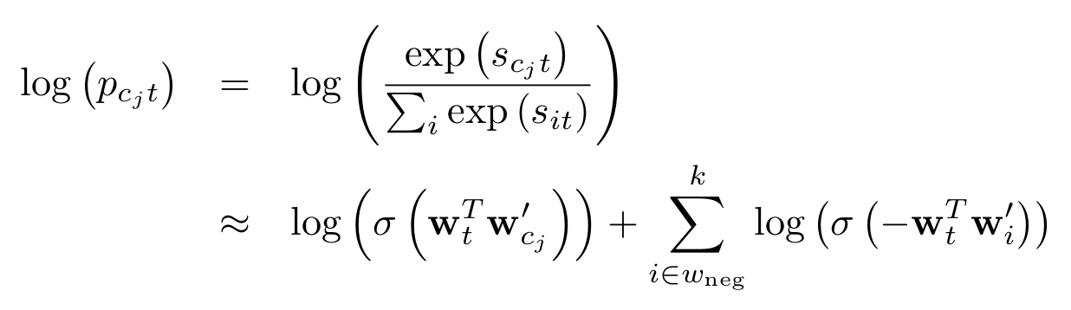
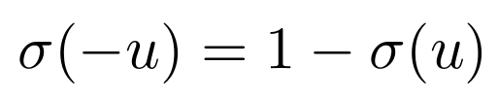
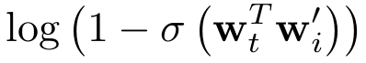
Improving speed and accuracy
Negative Sampling (NEG) - Skip Gram case
Computing loss and its gradient is expensive operation because of the normalization term
Sigmoid function:
The exact log probability is replaced with approximated expression:
the good: k ~ 30-40 hence dramatic reduction of computational complexity,
the bad: probability is not normalized
the ugly: never sure if it will work
Case study:
t=cat
c={dog, mouse, horse}
w_{neg}={animal, door, house, elephant}
Note: the quality of the learning will depend on sampled words

Slide 28
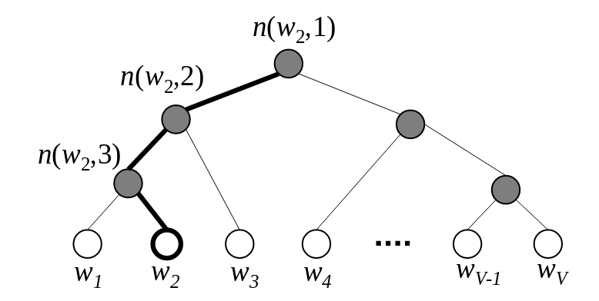
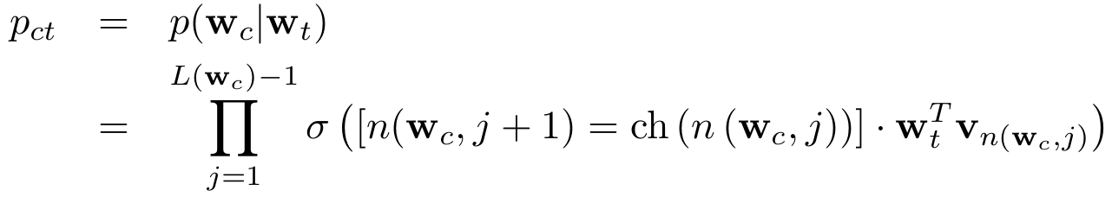




Improving speed and accuracy
2. Hierarchical Softmax
Each word is positioned by its index
in matrices W and W’
Standard Softmax function
Hierarchical Softmax treats words in matrix W’ by leafs of Huffman binary tree
The probability of observing word w_{c} given w_{t} is given then by
v₁
v₂
v₃
length of path for word w_{c}
Note: Huffman tree assigns short codes to frequent words
means the j-th unit on the path from root to the word w
left child of unit n

Slide 29

Improving speed and accuracy
Hierarchical Softmax
The probability of observing word w_{c} given w_{t} is given then by
Case study #1:
v₁
Given target word w_{t} we want to compute probability of observing context word w_{c}=w₂
From tree structure we have: L(w₂)-1=3
Additionally,
n(w_{c},1)=1
n(w_{c},2)=2
n(w_{c},3)=3
n(w_{c},4)=4
v₂
v₃
Note: Huffman tree assigns short codes to frequent words

Slide 30

Improving speed and accuracy
Hierarchical Softmax
The probability of observing word w_{c} given w_{t} is given then by
Case study #2:
v₁
Given target word w_{t} we want to compute probability of observing context word w_{c}=w₄
From tree structure we have: L(w₄)-1=2
Additionally,
n(w_{c},1)=1
n(w_{c},2)=2
n(w_{c},3)=4
v₂
v₃
Note: Huffman tree assigns short codes to frequent words
Note: Easier to compute than case #1

Slide 31


Improving speed and accuracy
Hierarchical Softmax
The probability of observing word w_{c} given w_{t} is given then by
Properties:
maximum number of inner units is n_{w}-1
frequent words require less computational power (short code) - fast training
average complexity is O(~log(n_{w})) instead O(n_{w})
probability is normalized to one
v₁
v₂
v₃
v_{N-1}

Slide 32
Implementation in gensim package
Hierarchical Softmax
red - not related with theory
blue - related with discussed theory
class gensim.models.word2vec.Word2Vec(
sentences=None, // sentences of iterable
size=100, // latent space size - dimensionality of vectors
alpha=0.025, // learning rate
window=5, // maximum size of the window during scan
min_count=5, // ignore all words with total frequency lower than this (OPT)
max_vocab_size=None, // limit RAM when building vocabulary
sample=0.001, // threshold for downsampling frequent words (OPT)
seed=1, // seed for random number generator
workers=3, // parallelization - number of threads
min_alpha=0.0001,
sg=0, // By default (sg=0), CBOW is used. Otherwise (sg=1), skip-gram is employed
hs=0, // if 1, hierarchical softmax, otherwise NEG (OPT)
negative=5, // number of negative samples (OPT)
cbow_mean=1, // if 0, use the sum, if 1 use mean for CBOW model
hashfxn=<built-in function hash>, // hash function to use to randomly initialize weights
iter=5, // number of iterations (epochs) over the corpus
trim_rule=None, // vocabulary trimming rule
sorted_vocab=1, // if 1 (default), sort the vocabulary by descending frequency before words indexing
batch_words=10000 // target size (in words) for batches passed to each worker )
https://radimrehurek.com/gensim/models/word2vec.html

Slide 33



Skip Gram paper evaluation
The performance of various Skip-gram models on the word analogy test
Reminder
https://arxiv.org/pdf/1301.3781.pdf

Slide 34
GloVe - Global vectors

Slide 35



GloVe - looking for analogies
For a given context/target pair we compute score
and probability:
This is what we know so far…
in general we have
local loss
Total loss (loss over corpus) - first sum represent scan along corpus (Skip-Gram model)

Slide 36

GloVe - looking for analogies
Total loss (loss over corpus) - first sum represent scan along corpus
Gradient of this is approximated with SGD with mini-batches.
Consider an example
the fox jumped over dog then fox jumped over cow then fox jumped over pigeon
However we can look globally on this problem:
the fox jumped over dog then fox jumped over cow then fox jumped over pigeon
A
B
C
and group all “fox” words to compute total contribution to loss from that word
A
B
C
This simplify problem a lot, now we have 3 operation instead of 6!

Slide 37




GloVe - looking for analogies
Total loss (loss over corpus) - first sum represent scan along corpus
Gradient of this is approximated with SGD with mini-batches.
the fox jumped over dog then fox jumped over cow then fox jumped over pigeon
In general we can write loss for fox word using co-occurrence matrix
where O is the co-occurrence matrix eg:
Finally total loss can be expressed in terms of co-occurrence matrix
Note: In order to compute co-occurrence matrix one has to scan all corpus once and compute statistics.
using simpler notation
with V being vocabulary size

Slide 38








GloVe - looking for analogies
Total loss (loss over vocabulary)
w define new variable
is normalized to 1
is definition of cross entropy!
Note: Skip-Gram model is a weighted sum of cross entropy error
By minimizing cross entropy H we minimize the distance between true distribution Q and learned p.
KL - divergence

Slide 39



A theory behind t-SNE
taken from t-SNE presentation!!
Very basic assumption:
We want to have p_{ij} to be equal to q_{ij} i.e. low dimensional vectors Y correctly model similarities between high-dimensional data X.
=
but how to do it?
We can define a measure between two distributions which will tell as how close those distributions are:
Kullback–Leibler divergence
We are going to minimize C with respect to Y vectors
Notes:
C is asymmetric
q_{ij} is force to be large as p_{ij}
but q_{ij} cannot be larger than one, due to normalization, hence stability
p_{ij} are computed once in the first stage of t-SNE

Slide 40





GloVe - looking for analogies
Total loss (loss over vocabulary)
w define new variable
is normalized to 1
KL - divergence
only the learned probability depends on W, W’
t-SNE like loss !

Slide 41
Yesss! We could use t-SNE solver for finding low dimensional word representations

Slide 42




GloVe - relation to word2vec
http://nlp.stanford.edu/pubs/glove.pdf
We started from skip-gram loss and finish with t-SNE like loss
sum over corpus (scan)
sum over vocabulary, weighted cross entropy error
GloVe - can we use another metric instead of H?
Of course, why not!!!?
They defined another loss, by replacing cross entropy with other measure of difference between true and learned distributions
The simplest one is least square loss:
where Q_{ij} and P_{ij} are unnormalized probabilities
Q_{ij} and P_{ij} can be very large, hence it is better to compare log of them
softmax is normalized
f is some function, hyperparameter of problem

Slide 43



GloVe - relation to word2vec
http://nlp.stanford.edu/pubs/glove.pdf
We started from skip-gram loss and finish with t-SNE like loss
sum over corpus (scan)
sum over vocabulary, weighted cross entropy error
GloVe - loss can be obtained from Skip-Gram model after few assumptions and phenomenological modifications
bias vectors
GloVe - is optimized with SGD

Slide 44
Wait! Does it look similar to you?

Slide 45








Collaborative filtering - Implicit feedback
<- Streszczenie papieru
Definiujemy zmienną binarną,
(preferencja - p)
oraz poziom pewności w p_{ui}
r_{ui} = np. liczba kliknięcia na produkt i, przez uzytkownika u
Pewność rośnie jak zwiększa się liczba kliknięć
W przypadku dużych różnic w wartościach można stosować ten wzór
Szukamy takiego wektora dsd oraz , że z których policzymy
wyznacznik preferencji danego użytkownika jako:
Defniujemy stratę do minumalizacji:
regularyzacja
GloVe solves same problem as Collaborative filtering with implicit feedback!
poziom pewności stanowi wagę z jaką preferencje danego użytkownika są określane.
Słowniczek
f - latent factor (10-200)
gamma - regularization (0.1-10)
alfa - confidence increment (~40)

Slide 46
Yesss! We could use ALS solver for finding low dimensional word representations!
Woooow! Finding word representation is actually solving recommendation problem!

Slide 47




Skip-Gram - relations to matrix factorization
They started with Skip-Gram and Negative sampling method
And shown that this method is equivalent to factorization of PMI matrix.
where:
#(w,c) - is co-occurrence matrix

Slide 48








Epilog GloVe - the fun part
GloVe loss
Let’s neglect biases and weight function and regularization term
This can be efficiently minimized with ALS algorithm, used for explicit feedback recommendations
Note: R=log(Q), X=W and Y=W’
From presentation about recommendations

Slide 49


Epilog GloVe - the fun part
I’ve solved GloVe loss with ALS
Simple ALS solver in Julia
What I did:
I’ve downloaded all papers of my supervisor from arxiv
Extracted all tex files and merged into one file.
Then normalized the text: removed most bad words from text.
Computed co-occurrence matrix O with window size 10
Resulting vocabulary was of size ~4300 words
Then created word embeddings using:
Implemented ALS solver (explicit feedback)
Implicit feedback solver (python package)
NMF of co-occurrence matrix (python)
SVD factorization of co-occurrence matrix (python)
word2vec (julia package)
Normalized singular values of co-occurrence matrix obtained with SVD.
I’ve chose latent space size to be 200

Slide 50


Epilog GloVe - the fun part
Word: kolasinski
word2vec ???
very poor results…
in both cases:
probably word2vec needs more data
Word: energy

Slide 51

Conclusions
GloVe - is between

Slide 52
Conclusions #2
word2vec is not deep learning!

Slide 53
References
http://nlp.stanford.edu/pubs/glove.pdf - GloVe paper
http://www-personal.umich.edu/~ronxin/pdf/w2vexp.pdf - nice tutorial about w2v, well explained with derivations
https://www.tensorflow.org/tutorials/word2vec/ - tensor flow tutorial about w2v, contains some basic definitions
https://cs224d.stanford.edu/syllabus.html - Stanford NLP course, contains a lot more information and details
https://arxiv.org/pdf/1301.3781.pdf - comparision of several techniques like CBOW, Skip-Gram, Nerual Network based…
http://papers.nips.cc/paper/5021-distributed-representations-of-words-and-phrases-and-their-compositionality.pdf - original Skip-Gram paper
https://cs224d.stanford.edu/lectures/CS224d-Lecture2.pdf - a lecture (same Stanford course) about w2v and GloVe
https://radimrehurek.com/gensim/index.html - probably most popular topic modeling library for python
https://arxiv.org/pdf/1402.3722v1.pdf - Deriving Mikolov et al.’s Negative-Sampling Word-Embedding Method
https://papers.nips.cc/paper/5477-neural-word-embedding-as-implicit-matrix-factorization.pdf - Paper about relation of Skip-Gram model to Implicit matrix factorization

